Slide 1
CS 205
Artificial Intelligence

Slide 2
Last Lecture
Evaluation and Features .... continued
Decision Trees
Naive Bayes
Regression
Neural Nets

Slide 3
Evaluation
Accuracy
Speed and scalability
time to construct model
time to apply model
latency and disk-resident data
Robustness
noise, missing values, irrelevant features, streaming data, portability
Interpretability
gaining insight from the model

Slide 4
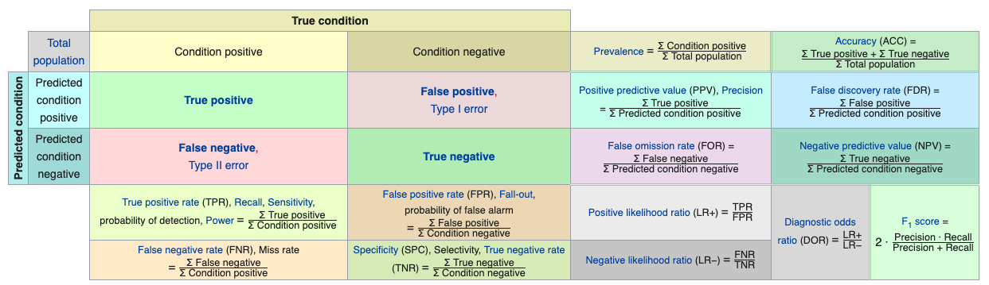
Accuracy
this is like god, an infallible being
Understand the tradeoffs between recall, precision and specificity.
Image source: Wikipedia
"accuracy" is only one way to look at it
this is your algorithm, flawed and imperfect

Slide 5

Sensitivity
COVID-19: "If you're trying to find out if a person is infected... then you want a highly sensitive test." –Dr. Fauci

Slide 6
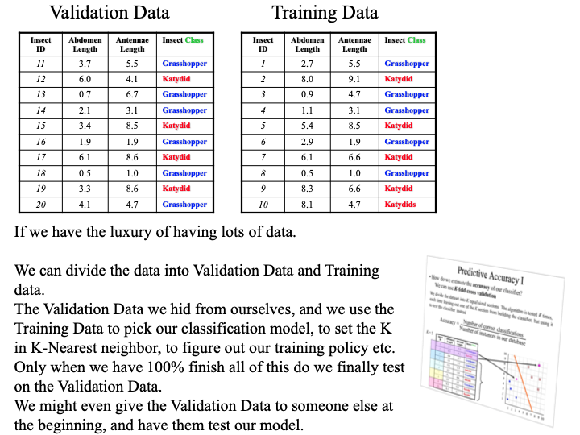
Evaluation
Internal versus external validation.
Cross-validation does not equate with external validation, a common mistake made by newbies.
Your final evaluations results are just that, final. Preferably, blind.

Slide 7
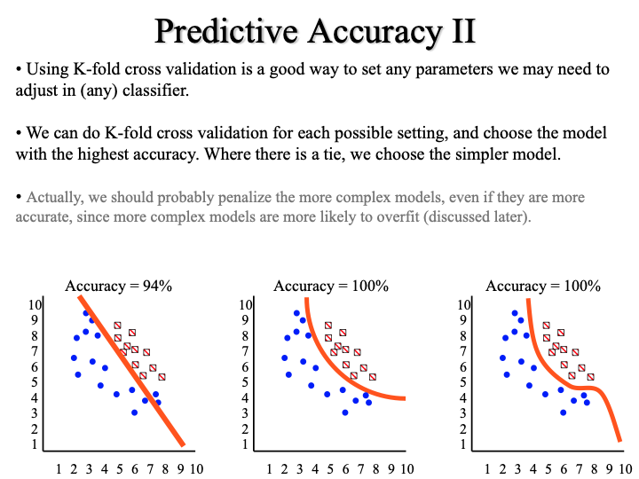
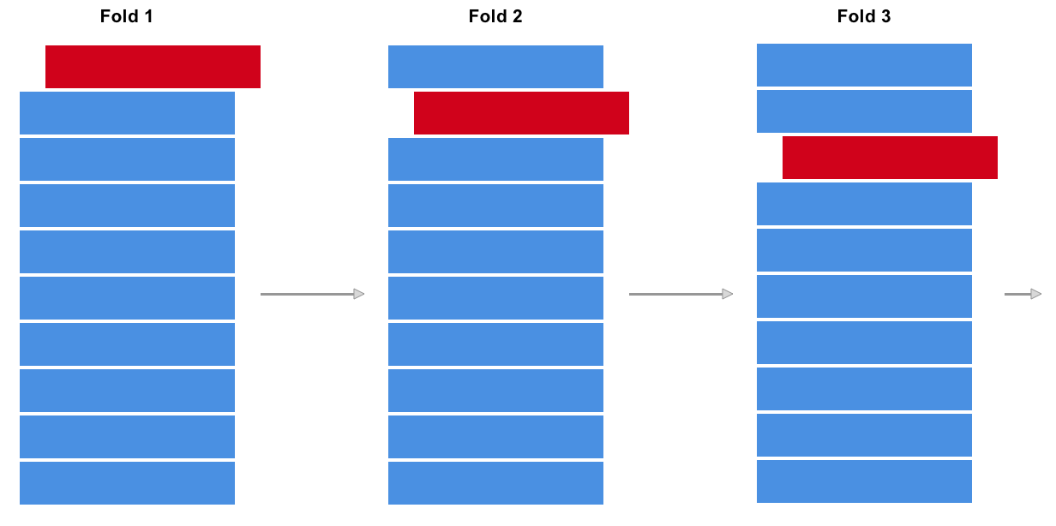
Cross-validation
What is K-fold cross validation? What is the difference between "validation" and "evaluation"?

Slide 8
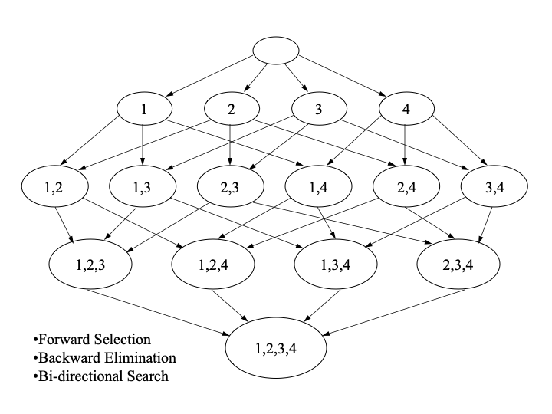
Feature Engineering
This is a search problem!
One, as some might say, is where most of the magic of machine learning happens.

Slide 9
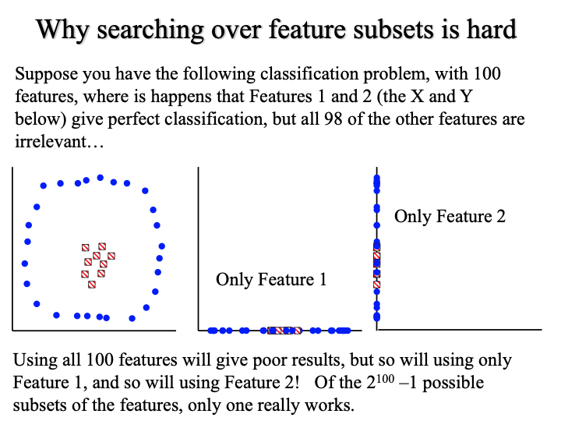
Feature Engineering
Combinations of features may be interesting, but... there may be too many combinations to search!

Slide 10
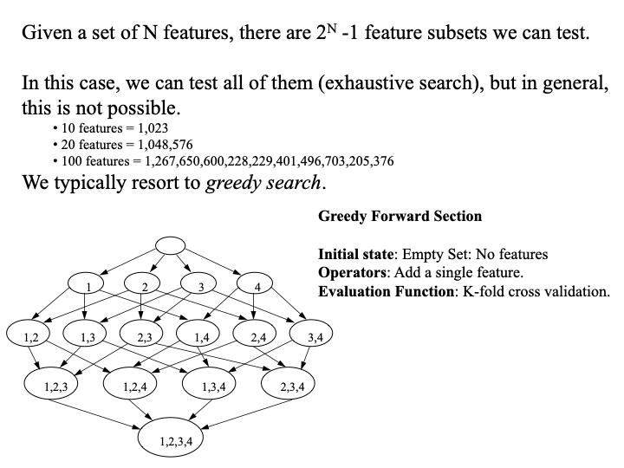
Feature Engineering
The default rate is established with no features.
Then, we can incrementally add features that greedily improve accuracy.
Feature generation:
BMI = height/weight²

Slide 11
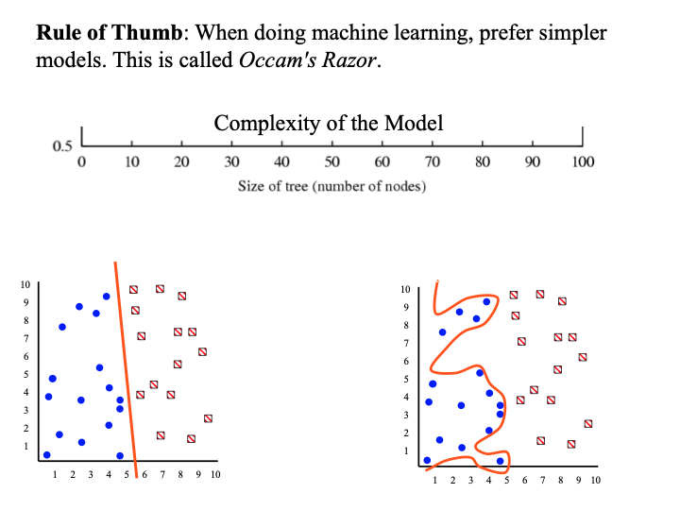
Overfitting
Simple is better.

Slide 12
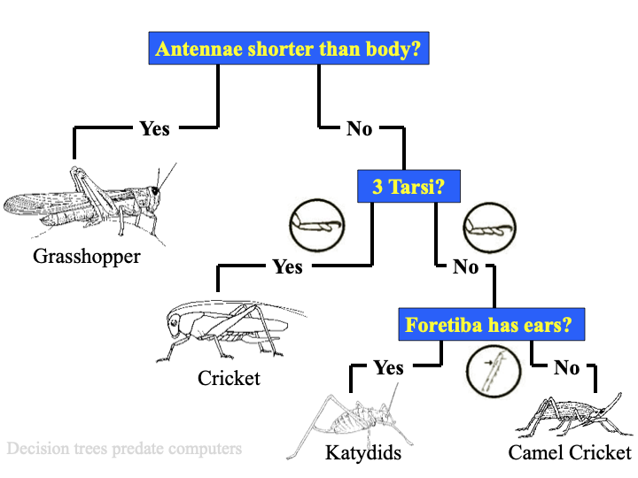
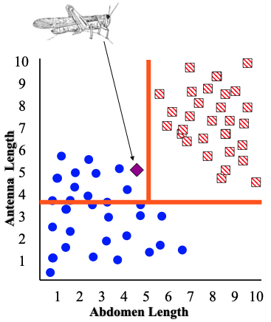
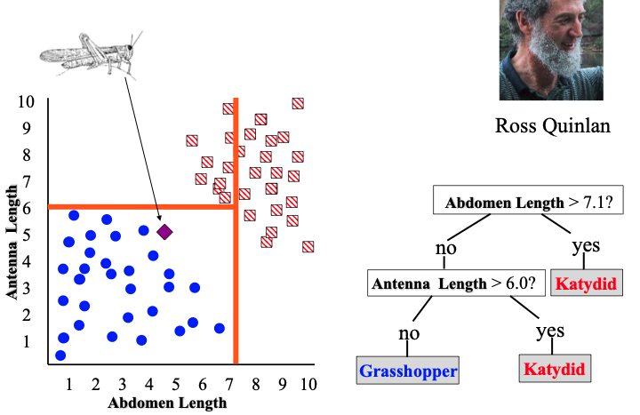

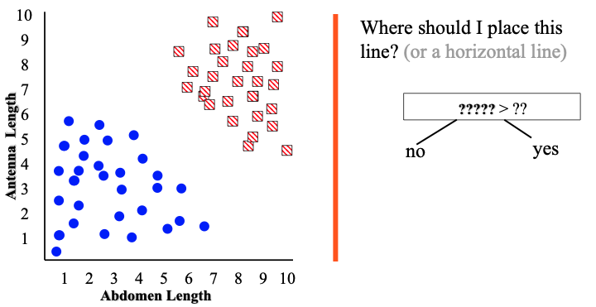
Decision Trees
A greedy algorithm often chooses next-best feature based on entropy or information gain metric.

Slide 13
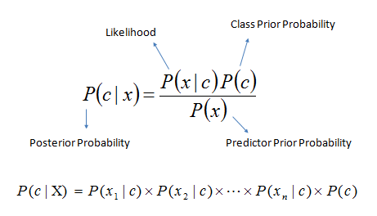
Naive Bayes
Effectively, a quadratic decision boundary.
This is the trouble.
This is the solution: independence.
Why is P(x|c) trouble? Chain rule — a lot of marginal probabilities to calculate!
P (x|c) = P(x₁...x_{n}|c) = P(x₁| x₂...x_{n},c) * P(x₂ | x₃...x_{n},c) ... * P(x_{n}|c)
Independence makes all that go poof.
Q: Why do we call Naive Bayes a generative model? A: Because we assume c "generates" x in P(x|c), which is similar to what we discussed in Topic Modelling.

Slide 14
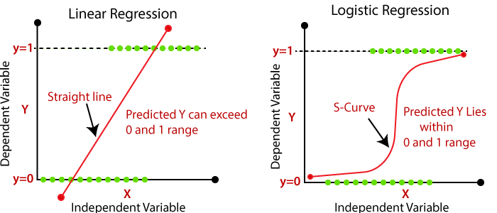



Regression
Effectively, a linear decision boundary.
Linear: continuous dependent variable
Logistic: discrete or nominal dependent variable (i.e., class)
Y = mX + b
The logit and sigmoid:
= mx +b
classification!

Slide 15
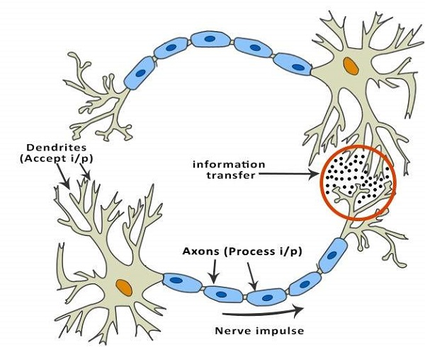
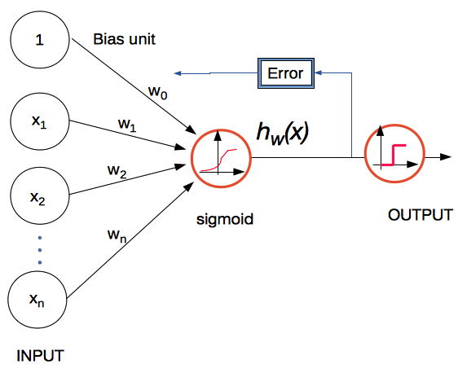
Neural Networks
Inspired from biology, perceptrons can be layered, and weights are adjusted via back propagation of errors, where the sigmoid again comes into play. These algorithms are computationally expensive.
A single layered neural net is precisely logistic regression!
The weights are are simply the log-odds ratios of each feature on the outcome variable, and they give us insight into feature importance. However, when we layer perceptrons, the interactions among layers, variables and weights becomes harder to interpret.

Slide 16
Next Time...
Project Presentation Rules:
10 minutes max time — points will be subtracted if you go over
it IS NOT a step-by-step walkthrough of your project
it IS a high-level summary/overview of your project
it IS like a project pitch, as you might have done for a hackathon
goals:
WHO — briefly introduce the team and roles
WHAT — explain what your project is about and does
WHY — motivate why it's interesting
HOW — briefly describe the technology and methods
MISC — what went wrong? how did you recover? future work? other thoughts...
each member of the team must participate
There will be a sign-up sheet for your team.

